Slide 1
BookScape Explorer

Slide 2
Introduction
To analyze book-related data and extract meaningful insights using SQL queries and a Streamlit-powered dashboard.

Slide 3
Tools Used
Python – For data extraction from Google API
Database – MySQL
API Integration: Google Books API
Libraries used – Pandas, requests, pymysql, streamlit
Visualization Tool: Streamlit

Slide 4
Dataset Overview
Extracted data from Google API.
Taken 10 genres of books and taken 500 books for each genre
Created a database containing 5000 books.
The table consists of various columns such as book_id, book_title, physical or ebooks, cost of the books, discount offered, publisher, year of publishing etc.

Slide 5
Key points implemented
Extracted data from Google Books API
Using python libraries established a connection with database and transferred the data to the database
Created multiple queries to analyze the dataset and derive meaningful insights
Visualized the insights in the form of drop down box in streamlit

Slide 6
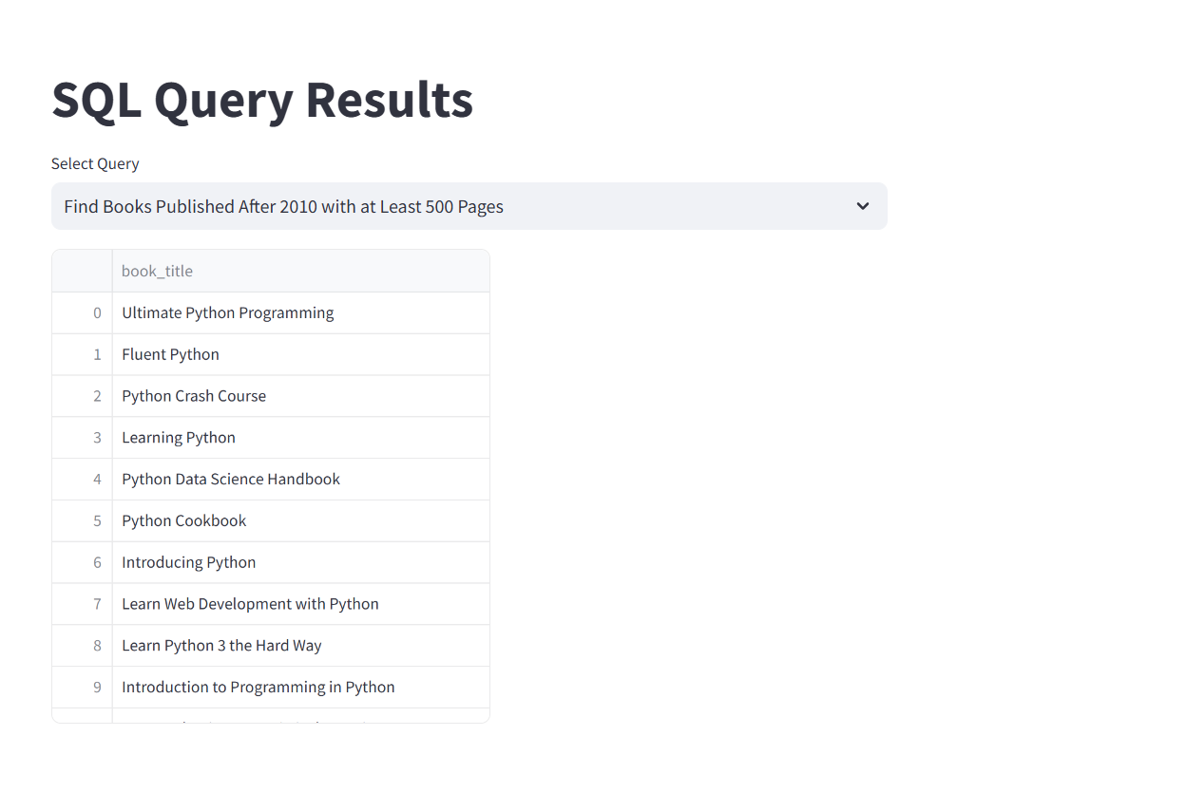
Visualization

Slide 7
THANK YOU

